Slide 1
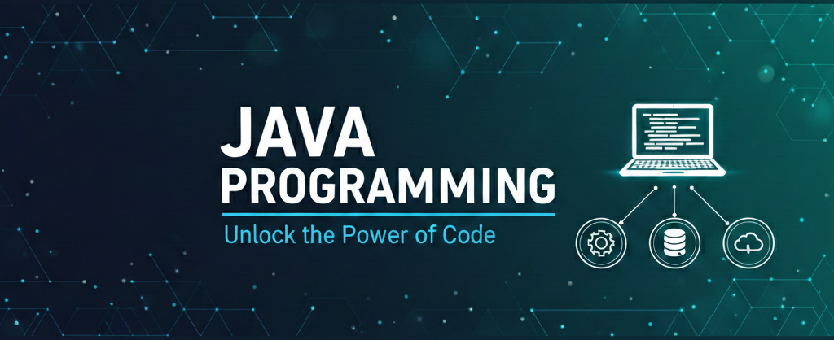
Data Types, Variables & Type Casting
Presenter: Shubham Rawat

Slide 2

Session Objective:
Understand variables and data types in Java
Differentiate Primitive vs Non-Primitive types
Perform type casting (widening & narrowing)
Use wrapper classes and take input using Scanner

Slide 3
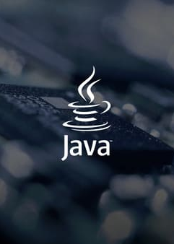
Topics Covered
Primitive types (byte, short, int, long, float, double, char, boolean)
Reference types
Memory allocation basics
Type casting (implicit & explicit)
Wrapper classes
Taking user input through Scanner

Slide 4
Data types

Slide 5
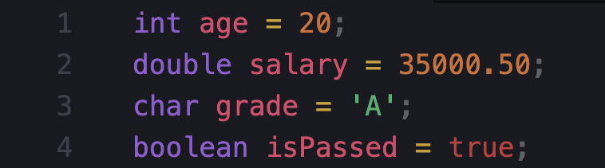
What is a Variable?
Variable = Named memory location used to store data
Rules for variable names
Must start with letter, _ or $
Cannot start with digit
No spaces (use camelCase)
Keywords not allowed (int, class, etc.)

Slide 6
Data Types in Java

Slide 7
Primitive Data Types (8 types)
byte (1 byte)
short (2 bytes)
int (4 bytes)
long (8 bytes)
float (4 bytes)
double (8 bytes)
char (2 bytes)
boolean (true/false)
Non-Primitive (Reference) Types
These store reference/address of objects.
String
Arrays
Classes / Objects
Interfaces

